Slide 1


Operation Analytics and Investigating Metric Spike
TRAINITY PROJECT BY:
DIVYANI SIROHI

Slide 2
C
O
N
T
E
N
T
INTRODUCTION
Job Data Analysis SQL Tasks
Context
Investigating Metric Spike

Slide 3


Case Study:
Job Data Analysis
Investigating
Metric spike

Slide 4

INTRODUCTION
In this project we are going to explore how to make sense of valuable information stored in a table called ‘Job _ data’. This table holds key details about jobs, actors, events, languages, time spent, organizations, and dates.
By using SQL queries, we can uncover hidden patterns and answer interesting questions.

Slide 5
Job Data Analysis :
SQL TASKS
Jobs Reviewed Over Time:
Objective
Calculate the number of jobs reviewed per hour for each day in November 2020Calculate
Throughput Analysis:
Objective
Calculate the 7-day rolling average of throughput(number of events per second)
Language Share Analysis
Calculate the percentage share of each language in the last 30 days
Objective
Duplicate Rows Detection
Objective
Identify duplicate rows in the data

Slide 6

CONTEXT
Case Study: Job data analysis
Tables: ds, event, time_spent, org, job_id, actor_id, language,
Software: MySQL workbench 8.0 CE

Slide 7
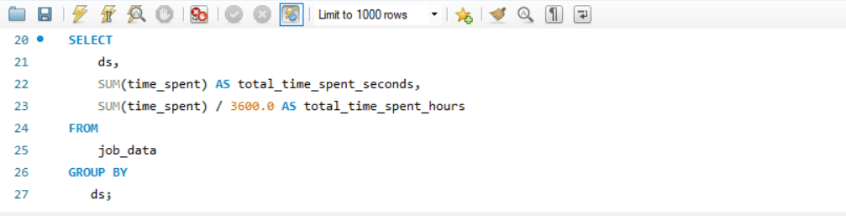
Jobs Reviewed Over Time
Objective:
The SQL query is like a special tool that goes through to calculate the number of jobs reviewed per hour for each day in November 2020.

Slide 8
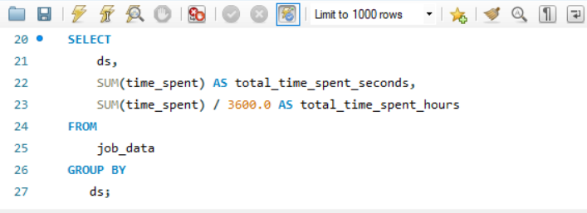
Jobs Reviewed Over Time
Objective:
The SQL query is like a special tool that goes through to calculate the number of jobs reviewed per hour for each day in November 2020.
In my database, there is an job _ data table with seven columns . We use the user_id and occurred_at columns to apply the date_format query.
To number of jobs reviewed per hour for each day inNovember 2020.

Slide 9
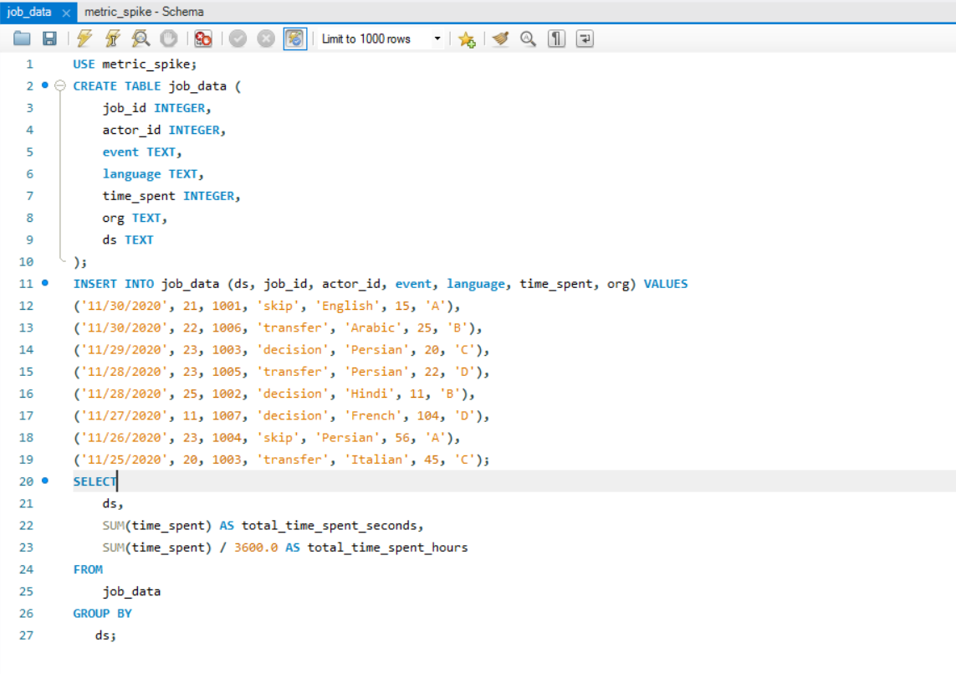
Jobs Reviewed Over Time

Slide 10
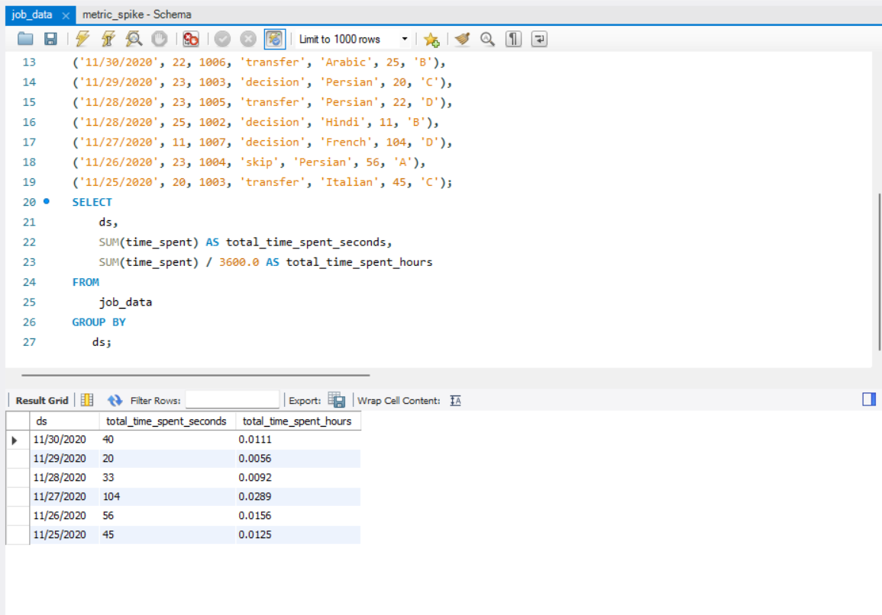
Jobs Reviewed Over Time

Slide 11
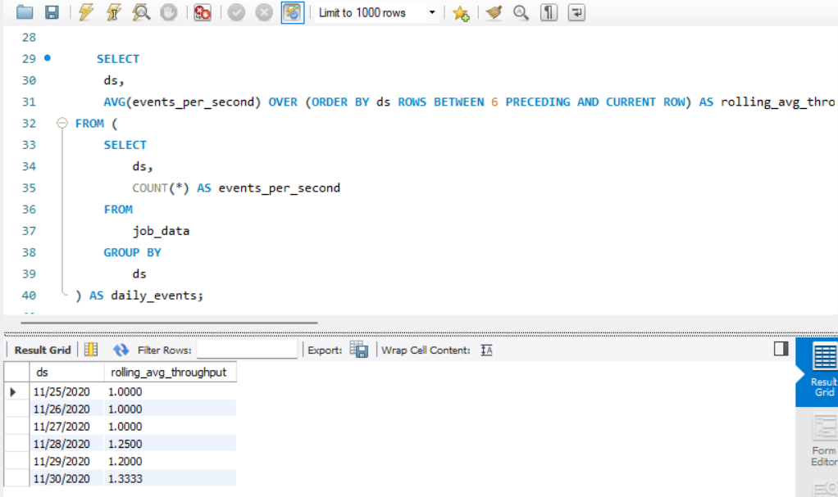
Throughput Analysis
Objective:
The SQL query is like a special tool that goes through to calculate the 7-day rolling average of throughput (number of events per second).

Slide 12
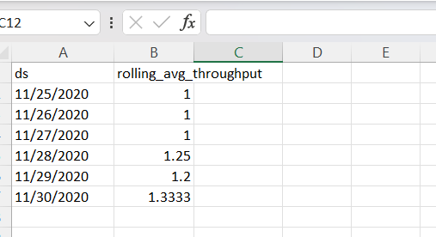
Throughput Analysis
In conclusion, the 7-day rolling average offers
a more reliable insight into throughput trends
By reducing noise and accounting for longer
-term Variations.
This makes it a preferred choice over the daily
Metric for analyzing throughput.

Slide 13
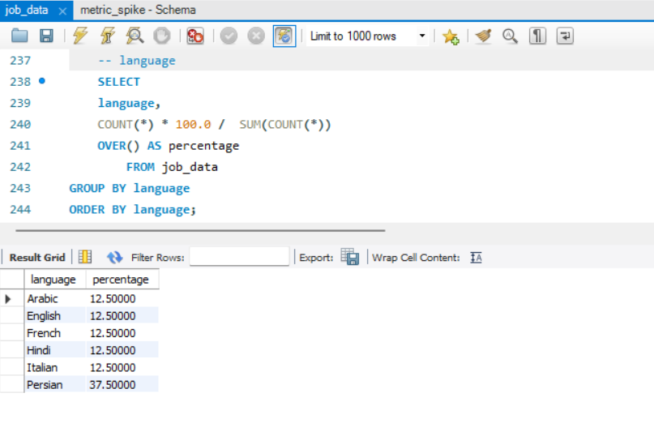
Language share analysis
Objective:
The SQL query is like a special tool that goes through to calculate the percentage share of each language in the last 30 days.

Slide 14
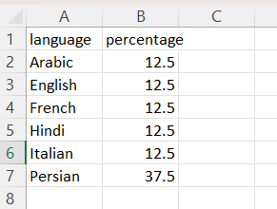
Language share Analysis
As language plays a critical role in engaging user, understanding the dominance of “Persian” offers insights that can be leveraged for content creation.
Localization efforts, and strategic decision- making to further enhance user engagement and satisfaction.

Slide 15
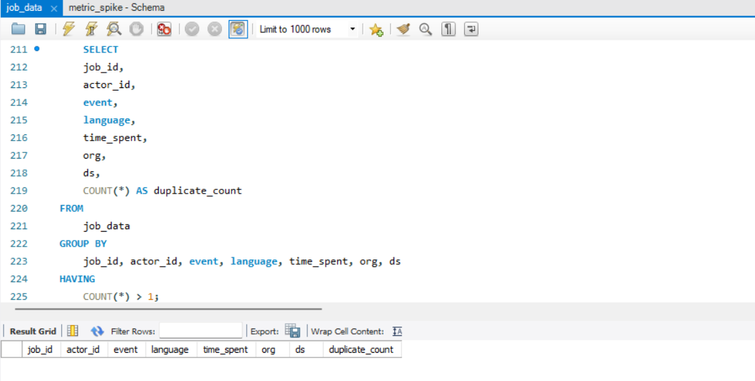
Duplicate Rows detection
Objective:
The SQL query is like a special tool that goes through identity duplicate rows in the data

